Slide 1
Multiple Linear Regression

Slide 2
Multiple Linear Regression
Multiple linear regression is similar to simple linear regression.In simple linear regression we had only one dependent and one independent variable whereas, in multiple linear regression we will teach machine to predict the values of dependent variable from two or more independent variables.Let’s get started.

Slide 3
Mathematical equation of multiple linear regression:
y = b₁X₁+b₂X₂+b₃X₃+….+b_{n}X_{n}
Here,
y is dependent variable
b₁,b₂… are constants
_{X1},X₂… are independent variables

Slide 4
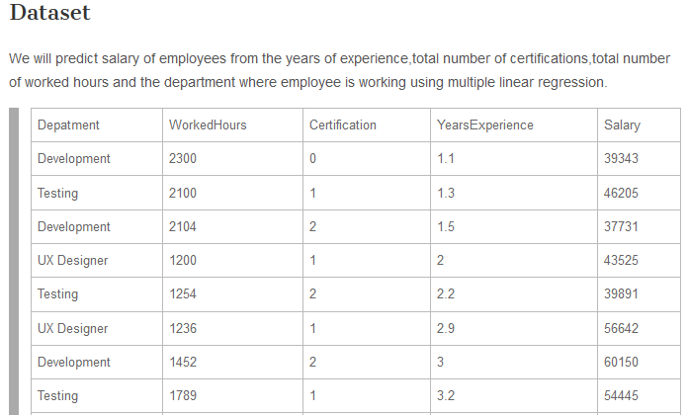

Slide 5
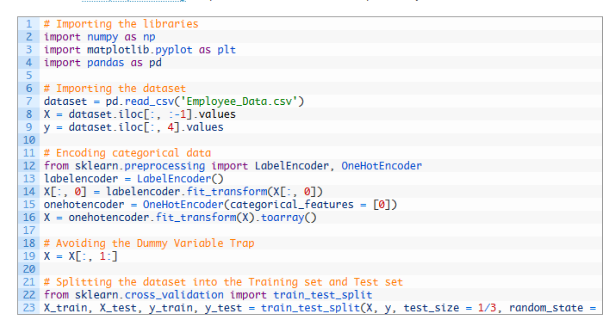

Slide 6
Dummy Variables
When we encode the categorical data,skLearn library in Python creates separate column for each categorical data.For example,In our dataset ‘Employee_Data.csv’ contains Department as categorical data like development,testing,UX.So,when we encode this data,we get separate column created for all three categories as follows.

Slide 7
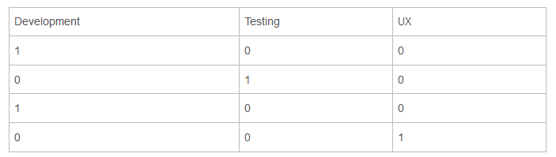

Slide 8
While implementing multiple linear regression we will eliminate one dummy variable.For example,in the first row development = 1, testing = 0 and UX = 0.Each row should contain value one in only one of the column.So consider the first row
If we remove development column then testing and UX are 0 which mean development should be 1
If we remove testing column,development is already 1 and all the other columns should be 0
If we remove UX column,development is already 1 and all the other columns should be 0

